Slide 1
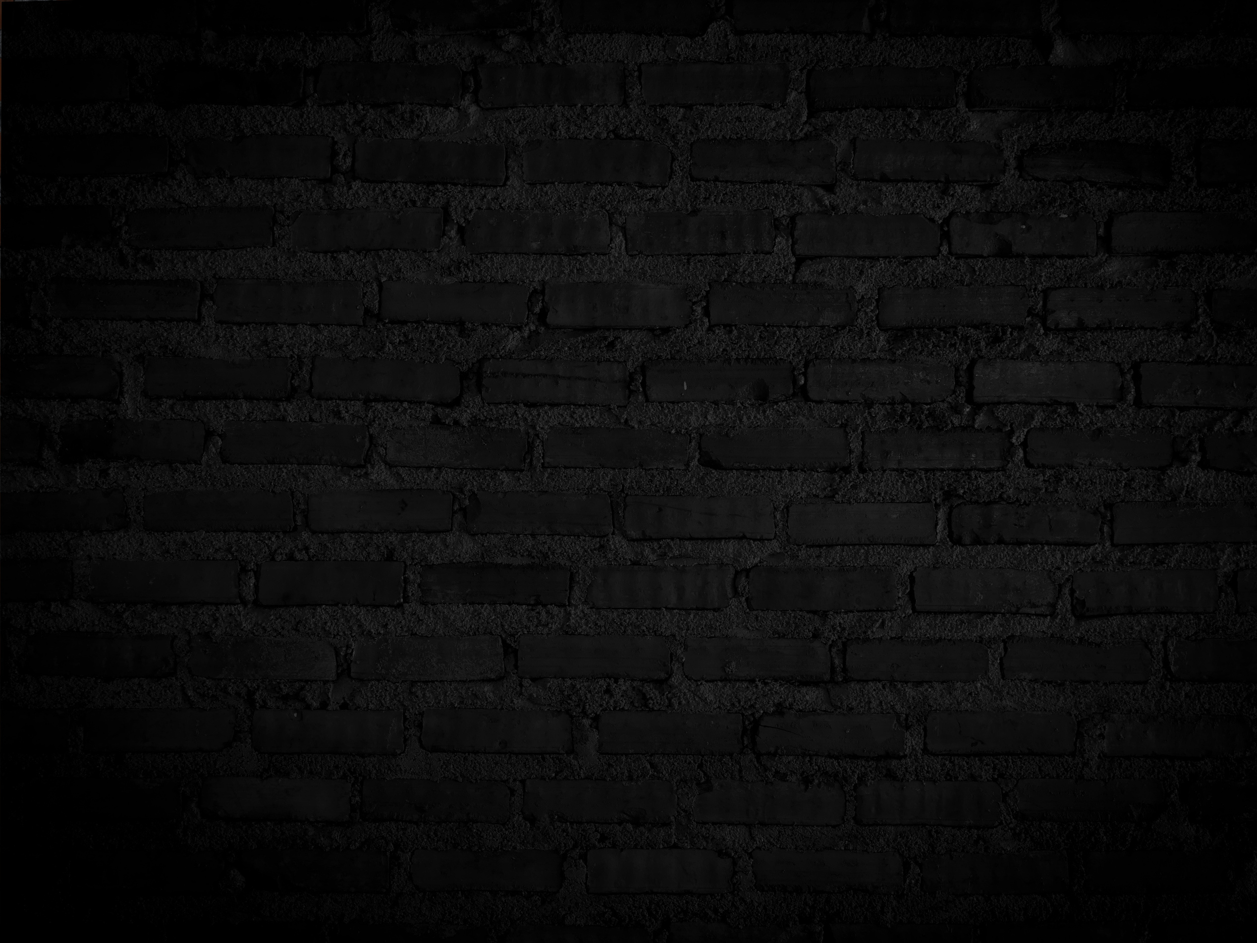








AUTOMATIC
DRAINAGE CLEANING DRONE
A drainage cleaning drone is an autonomous aerial vehicle designed to clear and maintain drainage systems.

Slide 2




DCD
ABSTRACT
This abstract discusses the development and application of a drainage cleaning drone, an innovative autonomous aerial vehicle designed for the efficient and cost-effective cleaning and maintenance of drainage systems.

Slide 3


objective
The primary objective of a drainage cleaning drone is to enhance the efficiency and effectiveness of drainage system maintenance. This includes
Debris Removal
Preventing Flooding
Cost Savings
Environmental Protection
Data Collection
Safety
Remote Operation
Time Efficiency

Slide 4

DIFFICULTIES FACED
Drainage cleaning drones, like any technology, can face several difficulties and challenges in their operation. Some of these difficulties include:
Navigational Challenges:
Obstacle Detection:
Environmental Conditions:
Power Supply:
Debris Removal:
Maintenance and Repairs:
Data Connectivity:
Regulatory Compliance:
Cost
Safety Concerns:

Slide 5


Statistics
Hardware Components:
Aerial Platform:
Sensors:
Cleaning Mechanism:
Communication System:
Software Components:
Operating System:
Computer Vision:
Control Software:
Data Analysis:
Remote Control Interface:

Slide 6
6.COMMUNICATION PROTOCOLS:
Wireless Communication:
Mesh Networking:.
7. Data Storage and Management:
Data Storage:
Cloud Services:
8.Security:
9. USER INTERFACE
Mobile App: .
10. Machine Learning and AI:

Slide 7


Borcelle 2023
THANK
YOU

